Slide 1
Text Mining Term Project
Sentiment Analysis on Drug Reviews
Ahmet Furkan Kocabas
Erdem Yavuz Hacisoftaoglu
Text Mining ECE 544
2024 – 2025
Fall

Slide 2
Content
Introduction
Motivation and Goal
Dataset Overview
Proposed Methodology
Results, Evaluation & Discussion
Conclusion

Slide 3
Introduction
Sentiment Analysis on Drug Reviews
Data Set: drugs.com
Text Mining Methods + Machine Learning & Deep Learning Models
Predicting Whether Reviews are Positive,Negative or Mixed Sentiment

Slide 4
Motivation and Goal
Motivation:
Sentiment Analysis: one of the most important NLP Task
Challenge:
Capturing the semantic of a document
Developing Robust Models to obtain high evaluation metrics

Slide 5
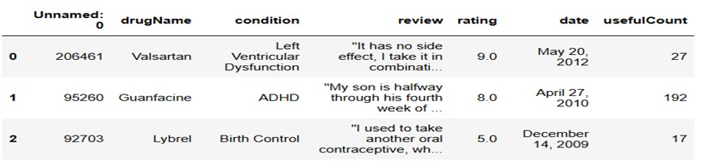
Dataset Overview
Train Set : (161297, 7), Test Set: (53766, 7)

Slide 6
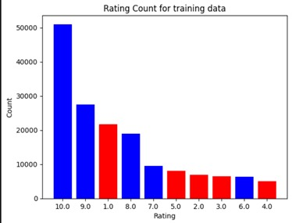
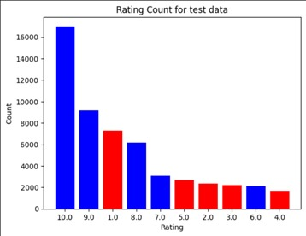
Dataset Overview

Slide 7
Methodology
Preprocessing:
Conversion of HTML elements
Lowercase conversion
Tokenization
Removal of Non-Alphanumerics, frequent and rare words, and stopwords
Class Mapping
Feature Extraction:
Used TF-IDF for Traditional Machine Learning models.
Used Word2Vec for advanced Deep Learning algorithms.
And used Transformer-based models such as BERT.

Slide 8
Methodology
Models:
Traditional ML Models:
Naive Bayes, Logistic Regression, Random Forest, Gradient Boosting
Deep Learning Models:
CNN, LSTM, BERT
Interpretations:
Comparing Models’ Performance based on metrics
Extracting false predictions and understanding the reasons behind

Slide 9
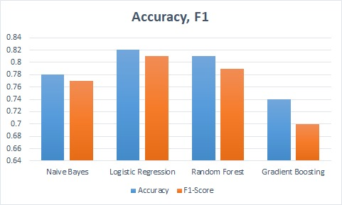
Results and Evaluation
Feature Extraction Method: TF-IDF
Up to 5000 features, including bi-gram windows
Models: (Binary Classification)
Logistic Regression
Precision: .81, Recall: .82, F1: .81
Naive Bayes
Precision .78, Recall: .78, F1: .77
Random Forest
Precision: .81, Recall: .81, F1: .79
Gradient Boosting
Precision: .75, Recall: .74, F1: .70

Slide 10
Results and Evaluation
Feature Extraction Method: Word2Vec
Static Word Embeddings
Vector Size: 50, 100, 200 (100 optimum)
Assumed to capture semantic meaning better
Deep Learning Models (Binary Classification):
LSTM: Precision: .83, Recall: .82, F1: 83
CNN: Precision: Precision: .78, Recall: .78, F1: .78

Slide 11
Results and Evaluation
BERT:
Bidirectional Encoder Representations Transformers
Contextualized Embeddings
Transformer Based Model
Pretrained BERT on lowercase English Text
Binary Classification
Three Class Classification + Class Balancing

Slide 12
Results and Evaluation
BERT & Binary Classification:
Precision: .92, Recall: .92, F1: .92
BERT & Three Class Classification
Class Balancing with random under sampling
Negative, Mixed Sentiment (or Neutral), Positive
Precision: .82, Recall: .81, F1: .81

Slide 13
Discussion
More naive representation + simple models
Provides promising results
Outperforms Deep Learning Models + Word2Vec
Possible Justifications:
Small Vocabulary Diversity: ~44k in ~165k reviews
Average token size of a review: ~40 tokens
Indicating narrow semantic context and simple narrative

Slide 14
Discussion
BERT:
Outperforms all other methods & models in binary classification
Powered by transformer technology
Better at capturing contextual meanings
Already pre-trained on large corpus
Even capable of capturing mixed sentiment (neutral) reviews
“Not Bad” → Predicted as Neutral whereas it was predicted as good in binary classification
.82 F1 Score

Slide 15
Discussion
Even BERT can miss context in some cases:
"I was on this for 5 years (and birth control pills for about 12 years), and would have told you how fabulous it was. <List all the benefits everyone else has listed, here.> Then a friend of mine convinced me to stop birth control all together for a while, and I turned into a new and better person! I dropped 5 lbs instantly, had a huge sex drive, more lubrication, and just felt better. I wouldn't say I was depressed before, but after going off of it, I would describe my time on birth control as feeling like I was inside a cloud. Less emotions in general, sometimes a little down. I'm bummed I'm back on it, but it seems to be the least impactful than the others. I might try Paragard to avoid the hormones.",
True Label: Neutral, Predicted Label: Positive
"I am a 12 year survivor of mirapex/Pramepexole. It was a miracle to begin with. I only slept about 4hrs a night but had enormous energy and never tired. That lasted nine years. But during that time I lost bladder control, impulse disorders, loss of concentration, myalgia neuropathy, falling asleep while driving, many more and augmentation. I was on .5 mg. Detoxing med free from this med was horrendous! After detox most of the side effects cleared up. But I still have issues with memory and concentration. This is the only med I took on a reg bases as my health was good. Im still suffering the side effects of the Withdrawl from it. Studies should be for longer than 12 weeks."
True Label: Negative, Predicted Label: Positive

Slide 16
Conclusion
Sentiment Analysis
Drug Reviews & Ratings (drugs.com)
Utilized different representation methods
Different Machine Learning and Deep Learning Models
BERT: Winner but with some weaknesses

Slide 17
THANKS FOR YOUR ATTENTION

